Slide 1
EMBRYOLOGY
Mr. Geoffrey M Moriasi
Clinical Occupational Therapist
Msambweni County Referral Hospital
Part Time Lecturer, Department Of Occupational Therapy
KMTC, Mombasa Campus

Slide 2
Lecture Objectives
Introduction
The pre natal period
Pre- embryonic period
Embryonic period
Fetal period

Slide 3
Stages of embryogenesis
Cleavage
Gastrulation
Organogenesis

Slide 4
Gametogenesis
Neurulation
Differentiation of mesoderm
Differentiation of endoderm
Organogenesis

Slide 5
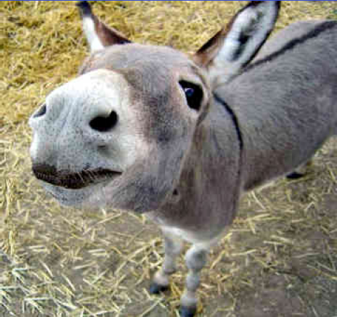

Slide 6
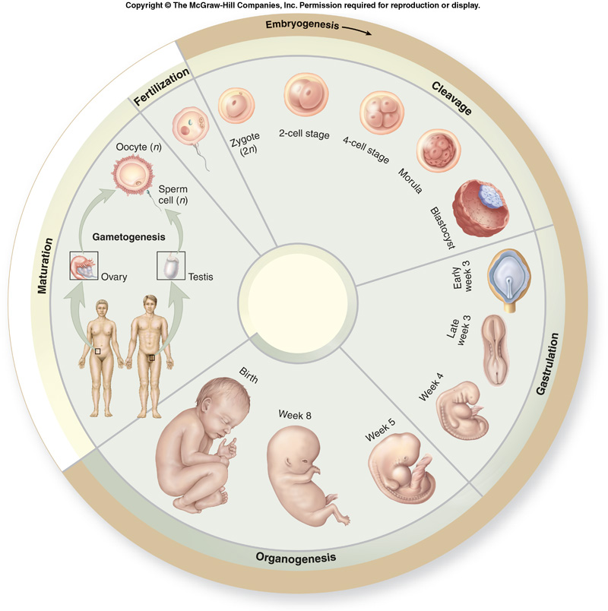
Human Anatomy,
Embryology

Slide 7
Embryology
The study of the developmental events that occur during the prenatal period.

Slide 8
Embryology
Begins with Fertilization:
A single fertilized cell divides by mitosis to produce all of the cells in the body.

Slide 9
The Prenatal Period
The first 38 weeks of human development
between fertilization and birth.
The pre-embryonic period:
first 2 weeks of development
zygote becomes a spherical, multicellular structure.
The embryonic period:
third through eighth weeks
all major organ systems appear.

Slide 10
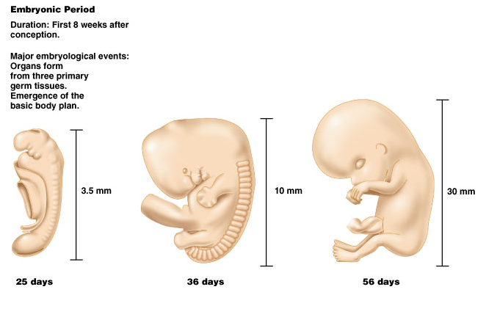

Slide 11
The Prenatal Period
The Fetal Period:
Includes the remaining weeks of development prior to birth
The fetus continues to grow
Its organs increase in complexity

Slide 12
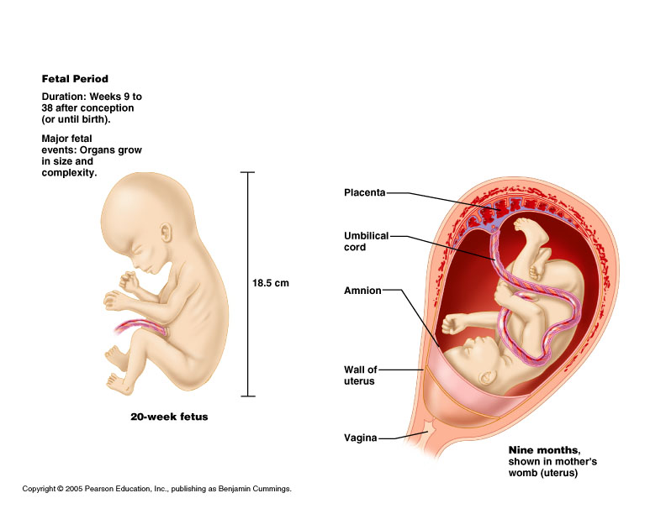

Slide 13
The Stages of Embryogenesis
Cleavage:
zygote divides by mitosis
forms a multicellular structure called a blastocyst.
Gastrulation:
blastocyst cells form three primary germ layers (mesoderm, endoderm and ectoderm)
basic cellular structures from which all body tissues develop.
Organogenesis:
three primary germ layers arrange themselves in ways that give rise to all the organs within the body.

Slide 15
Gametogenesis
Following birth, an individual undergoes maturation.
the body grows and develops
the sex organs become mature
the sex organs then begin to produce gametes

Slide 16
Neurulation: differentiation of ectoderm
Notochord forms in area of primitive streak.
This induces neurulation
Neural plate
Neural folds
Neural Groove
Neural tube

Slide 17
Differentiation of Mesoderm
Five categories:
Notochord
Paraxial mesoderm
Somites: most bone, muscle, cartilage, dermis,
Intermediate mesoderm
Urinary and reproductive systems
Lateral Plate Mesoderm
Cardiovascular, lining of body cavities, limbs
Head Mesenchyme
musculature of face

Slide 18
Differentiation of Endoderm
Linings of digestive, respiratory and urinary tracts.
Thyroid,parathyroid, thymus, most of liver, pancreas and gallbladder.

Slide 19
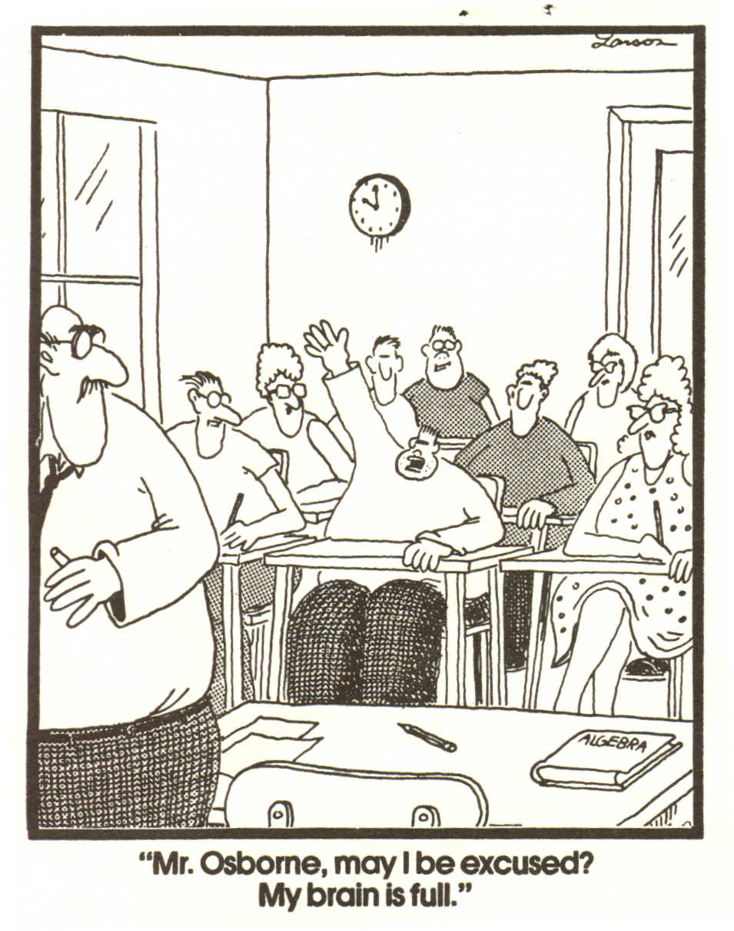

Slide 20
A point to note
The upper and lower limbs (including the shoulder girdle and pelvic girdle) begin development in the 4th week of gestation.
Usually the upper limb begins development first, with the lower limb often lagging 2-3 days behind.
The limbs are well differentiated by week 8.

Slide 21
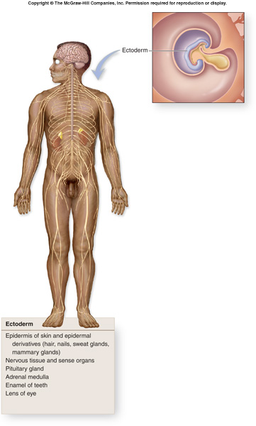

Slide 22
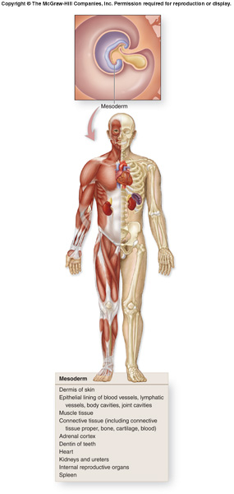

Slide 23
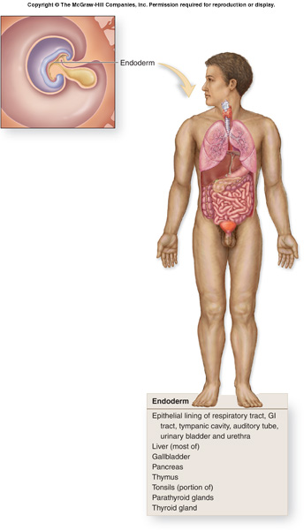

Slide 24
Organogenesis
Once the three primary germ layers(mesoderm, ectoderm and endoderm) have formed, and the embryo has undergone folding, organogenesis begins.
By the end of the embryonic period, the embryo is slightly longer than 2.5 centimeters (1 inch), and yet it already has the outward appearance of a human.

Slide 25
Thank you for listening
Read about the Integumentary/skin

